Slide 1

Memory consumption. Garbage collector.
Deeper in the shadows

Slide 2

Do You see something strange?

Slide 3

Just One

Slide 4
Memory lifecycle
Memory allocation
Use (reading-writing variables)
Exemption of allocated memory when it is no longer necessary

Slide 5
Memory allocation by initialization
var n = 123; // memory allocation for number var s = "azerty"; // memory allocation for string type var o = { a: 1, b: null }; // memory allocation for object and all nested variables var a = [1, null, "abra"]; // (like object) memory allocation for array and inner items function f(a) { return a + 2; } // for function, because it is called as an object // this is also memory allocation - anonymous function someElement.addEventListener('click', function () { someElement.style.backgroundColor = 'blue'; }, false);

Slide 6
Memory allocation by calling the function
var d = new Date(); var e = document.createElement('div'); // memory allocation for DOM object //Some methods allocate memory for new values or objects: var s = "azerty"; var s2 = s.substr(0, 3); // s2 is a new object of string type var a = ["ouais ouais", "nan nan"]; var a2 = ["generation", "nan nan"]; var a3 = a.concat(a2); // a new array with 4 elements by concatenating elements 'a' and 'a2'

Slide 7
Memory use
reading-writing variables is no magic

Slide 8

Exemption of allocated memory
The problem of garbage collection has no clear algorithmic solutions

Slide 9
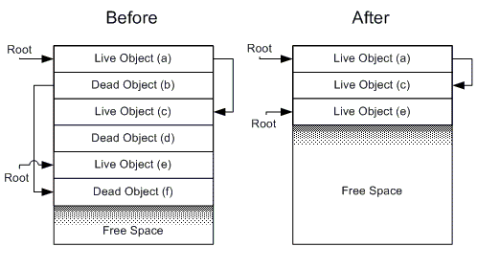
Exemption of allocated memory

Slide 10
Everyday practices
function getPos(elem) { var rect = elem.getBoundingClientRect(); return { x: rect.left, y: rect.top }; } var pos = getPos(elem1); elem2.style.left = pos.x + 'px'; elem2.style.top = pos.y + 'px';
var _posObj = {}; function getPos(elem) { var rect = elem.getBoundingClientRect(); _posObj.x = rect.left; _posObj.y = rect.top; return _posObj; } var pos = getPos(elem1); elem2.style.left = pos.x + 'px'; elem2.style.top = pos.y + 'px';

Slide 11
Everyday practices
var arr = [[1, 2], [3, 4]]; arr.forEach(function (a) { a.forEach(function (b) { console.log(b); }); });
var arr = [[1, 2], [3, 4]]; for (var i = 0, il = arr.length; i < il; i++) { for (var j = 0, a = arr[i], jl = a.length; j < jl; j++) { console.log(a[j]);
}
}

Slide 12
Everyday practices
Try to use variables inside functions, instead of "unlinking"
Null instead of delete
var o = {x: 1}; o = null; o; // null o.x // TypeError
var o = {x: 1}; delete o.x; // true o.x; // undefined
global variables are not collected

Slide 13
Everyday practices
Remove listeners!
Not only from DOM!

Slide 14
Small recommendations
Clear local cache if you use it
If you need a list of items of the same type, use array
Track closures
Beware of traps associated with performance

Slide 15
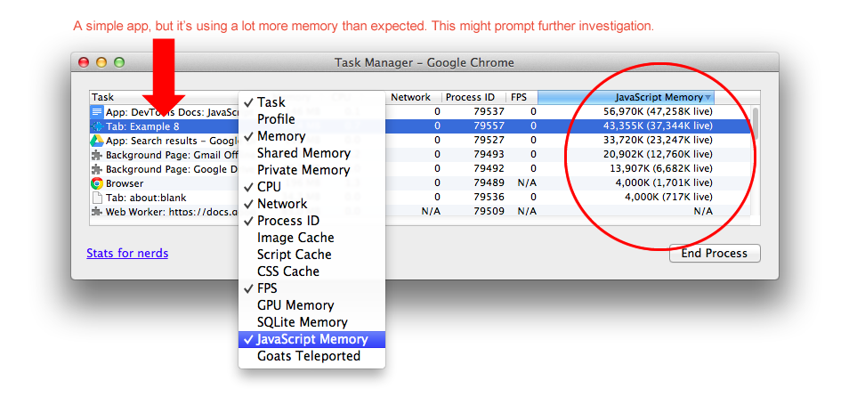
Chrome Task Manager

Slide 16
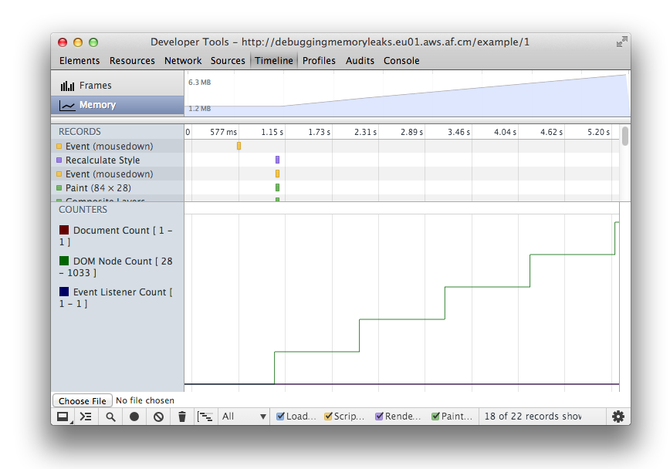
Troubles

Slide 17
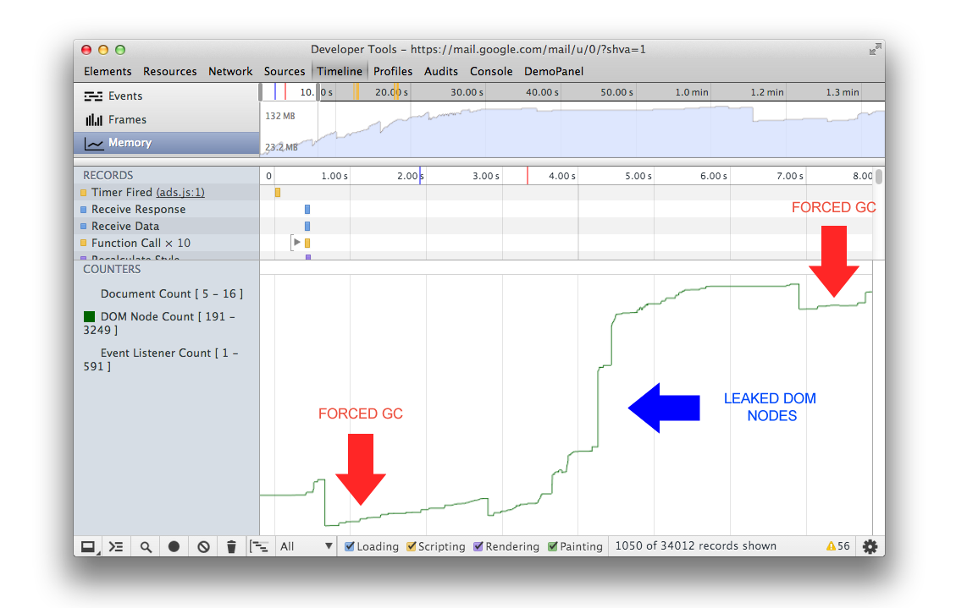
Problems

Slide 18
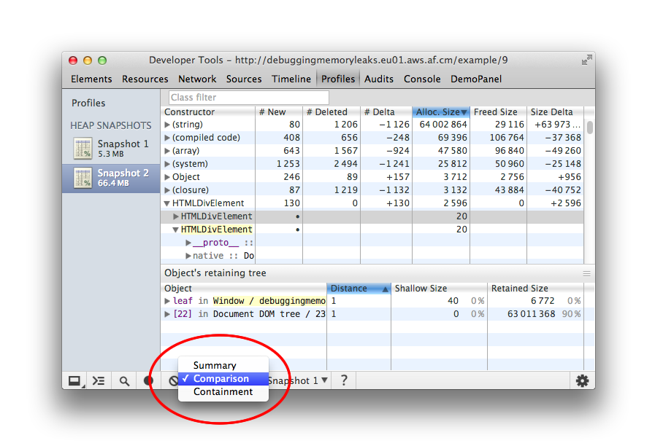
Snapshot

Slide 19
Comparison
Take a heap snapshot before performing an operation;
Perform an operation (interact with a page in some way that you believe to be causing a leak);
Perform a reverse operation (do the opposite interaction and repeat it a few times);
Take a second heap snapshot and change the view of this one to Comparison, comparing it to snapshot 1.

Slide 20
Profiling
cache a snapshot of timeline for critical places
identify the bottlenecks
isolate and optimize them in a controlled environment outside of your application
start with the slowest things
check the results on different computers and different browsers; eliminate distortions
JavaScript Profiling With The Chrome Developer Tools

Slide 21
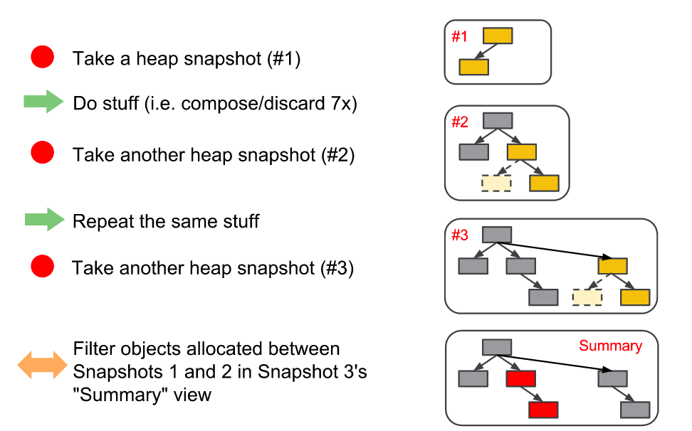
3 snapshots
“3 snapshot” technique

Slide 22


Static memory allocation

Slide 23
Static memory allocation
Measure and determine of the maximum number of active objects of each type required for the entire range of application scenarios.
Migrate code so that the maximum number of objects is assigned in advance, and then perform a manual call and release, instead of creating them in the normal case.

Slide 24
Object Pool
function Pool(Constructor, count) { var objects = {}, quantity = 0, freeObjects = [], usedObjects = []; function create(id) { var obj; obj = new Constructor(); obj.release = function () { var i; freeObjects.push(id); // remove id from used array i = usedObjects.indexOf(id); usedObjects[i] = usedObjects[usedObjects.length - 1]; usedObjects.length -= 1; }; objects[id] = obj; return id; } function allocate(count) { var i, l; for (i = 0, l = count; i < l; i += 1) { create(i); quantity += 1; freeObjects.push(i); } }
this.get = function () { var id; if (freeObjects.length > 0) { id = freeObjects.pop(); } else { id = create(quantity); quantity += 1; } usedObjects.push(id); return objects[id]; }; this.heap = objects; this.usedIDs = usedObjects; allocate(count); }

Slide 25
So what?
Measure. Understand. Correct. Repeat.
&
Optimization vs Refactoring

Slide 26
Checklist
Track memory allocation.
Try to use variables inside function, instead of “unlinking”. Don't use delete.
Don't use window as the global scope - it isn't cleared by Garbage Collector.
Don't forget to remove event handlers.
If you use local cache, take care of clearing it up.
If you want to use a set of numbers or a list of same-type objects, use an array.
Track closures and values that are returned from functions.
Beware of performance-related traps.
Start using the technique of static memory allocation.
Track memory leaks; this is especially acute for single-page apps. You may use the technique of 3 snapshots for that purpose.

Slide 27
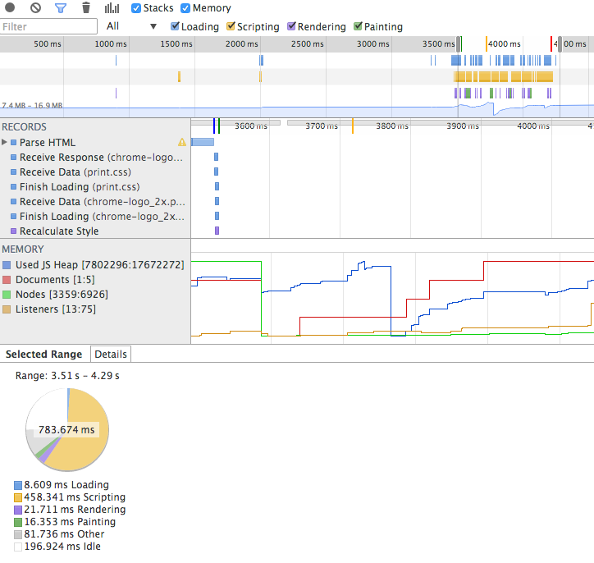
Performance Testing
memory-stats.js
SunSpiders
Kraken

Slide 28
But you can do it yourself
var totalTime, start = window.performance.now, iterations = 1000; while (iterations--) { // Code snippet goes here } // totalTime → the number of milliseconds taken // to execute the code snippet 1000 times totalTime = window.performance.now - start;

